Slide 1
DR.SNSRCAS, CBE
SUBJECT: ADVANCED JAVA PROGRAMMING
COURSE CODE:16UCA502
TITLE: Difference between Servlet and JSP
YEAR: V SEMESTER 2022-2023 (ODD)

Slide 2
Difference between Servlet and JSP
In brief, it can be defined as Servlet are the java programs that run on a Web server and act as a middle layer between a request coming from HTTP client and databases or applications on the HTTP server. While JSP is simply a text document that contains two types of text: static text which is predefined and dynamic text which is rendered after server response is received.

Slide 3
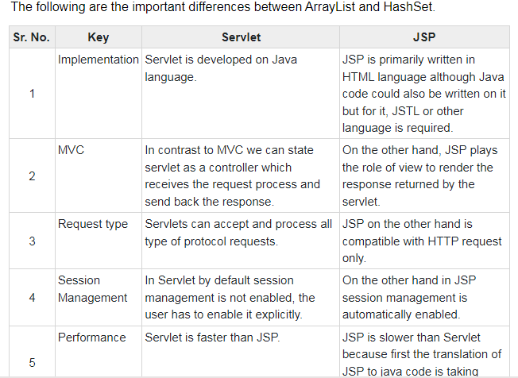
Difference between Servlet and JSP

Slide 4
Difference between Servlet and JSP

Slide 5
THANK YOU

